Slide 1
BIO EOC Review
Ms. Idris

Slide 2
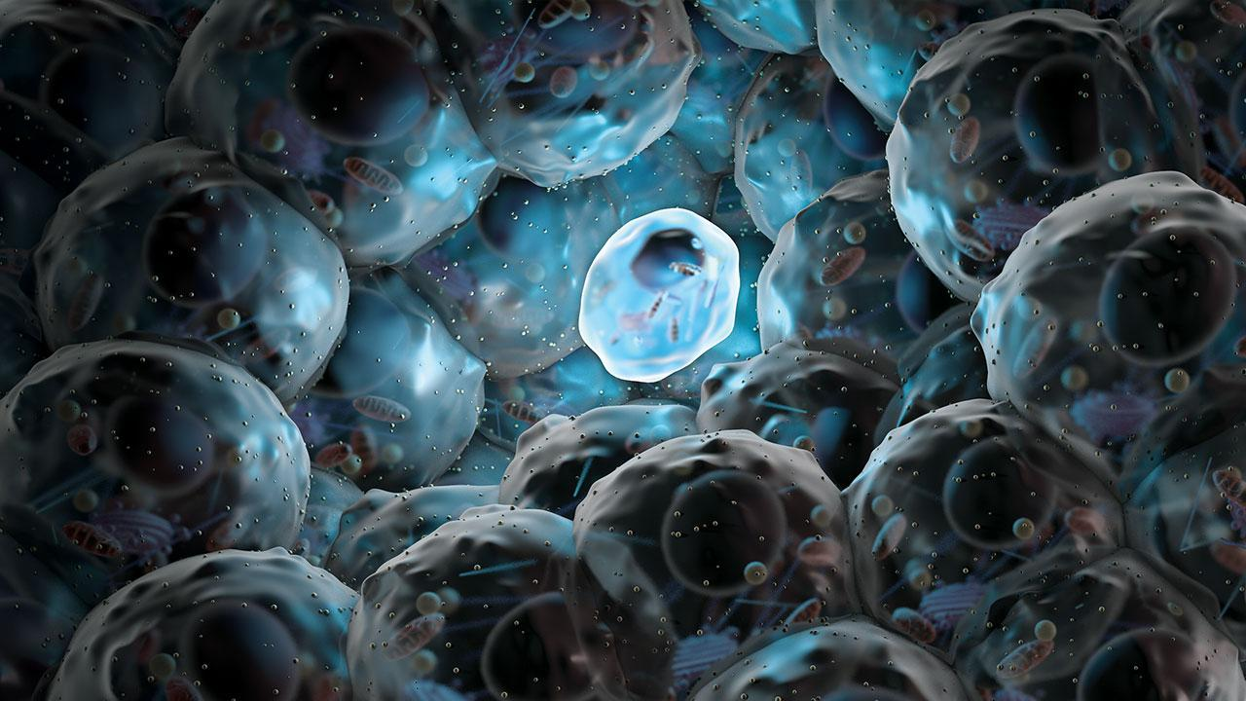
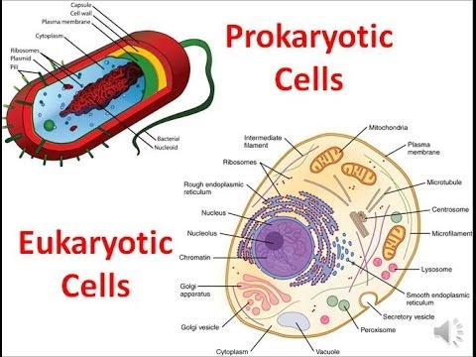
Cells
Cell theory - 3 parts
1) cells are basic unit of life
2) cells come from existing cells
3) all organisms are composed of cells
Prokaryotic versus Eukaryotic
A) simple A) complex
B) has no nucleus B) has a MB nucleus
C) has no MB organelles C) has MB organelles
D) includes bacteria D) includes protists, fungi, plants, and animals

Slide 3
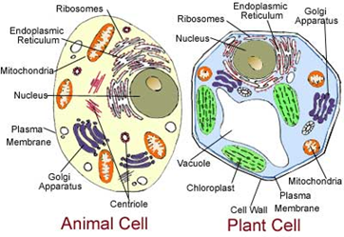
Cells
Organelles – compartments for carrying out specific jobs / chemical reactions
1) chloroplast – photosynthesis
2) mitochondria – cellular respiration
3) ribosomes – protein synthesis
4) vacuoles – storage
5) nucleus – contains DNA and
controls cell actions
6) nucleolus – site of ribosome formation
Cell theory - 3 parts
1) cells are basic unit of life
2) cells come from existing cells
3) all organisms are composed of cells
Prokaryotic versus Eukaryotic
A) simple A) complex
B) has no nucleus B) has a MB nucleus
C) has no MB organelles C) has MB organelles
D) includes bacteria D) includes protists, fungi, plants, and animals

Slide 4
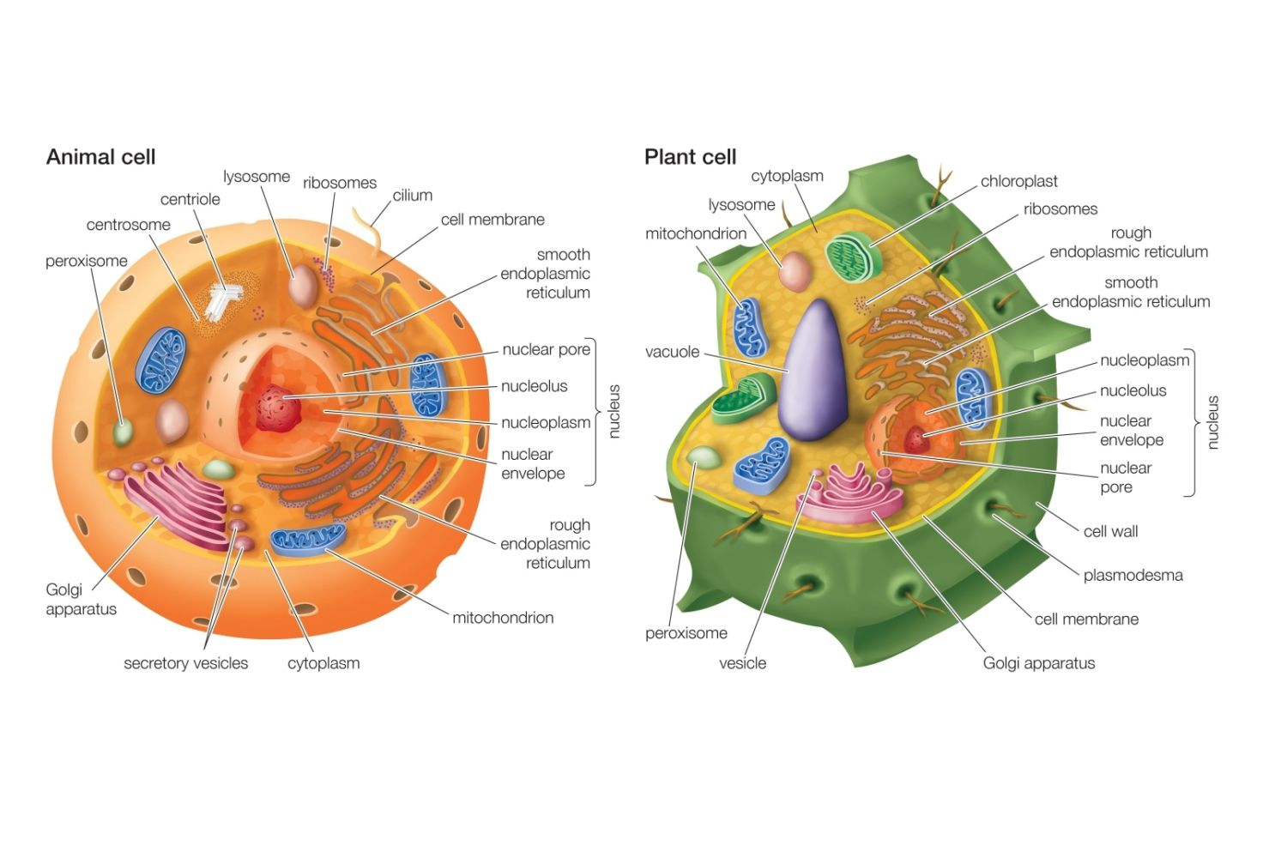
Cells Continue….
Plant versus Animal
A) has cell wall A) no cell wall
B) has chloroplasts/plastids B) has no plastids/chloroplasts
C) has large vacuole C) has small vacuoles

Slide 5
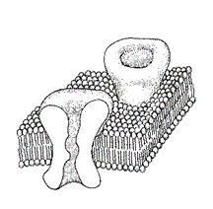
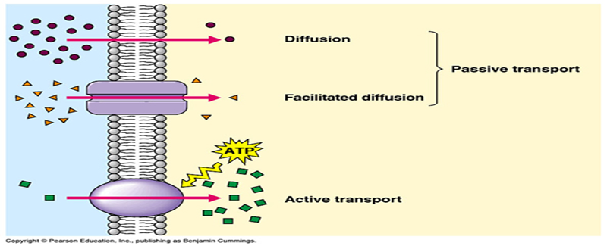
Cellular Transport
Plasma membrane controls homeostasis (balance)
Structure – composed of a phospholipid bilayer with
embedded proteins “gates”
Function – acts as a selectively permeable boundary
around the cell.
Types of Passive Transport – no energy required
1) Diffusion – moves substances from high to low concentrations down their concentration gradient
2) Osmosis – the diffusion of water from high to lower water concentrations down its concentration gradient
Ex) cell in salt water – shrivels Ex) cell in fresh water swells
3) Facilitated diffusion – movement of a substance down its concentration through a transport protein channel
Active Transport – requires energy – moves substances against the concentration gradient from low to high concentrations

Slide 6
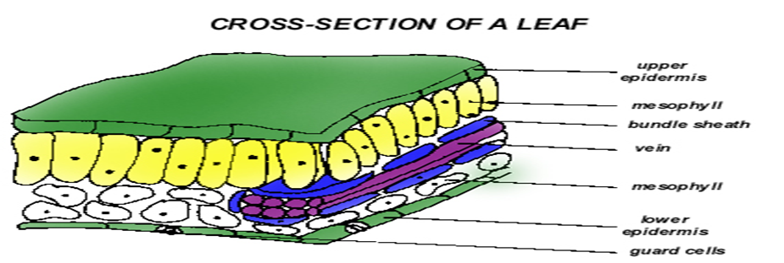
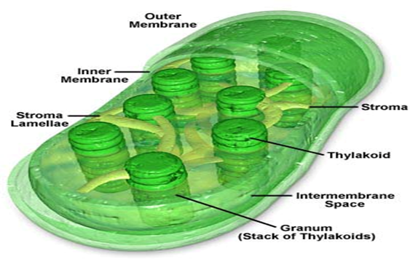
Photosynthesis
The process used by producers to convert sunlight to chemical energy in glucose
Overall equation: 6CO₂ + 6H₂O → C₆H₁₂O₆ + 6O₂
Occurs in the palisade layer of leaves (yellow layer under the upper epidermis)
Large numbers of chloroplasts are found in these mesophyll cells.
Chloroplasts are the cellular site of photosynthesis. The light reaction of photosynthesis occurs on the inner membrane called the thylakoid.

Slide 7
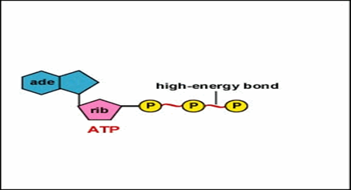
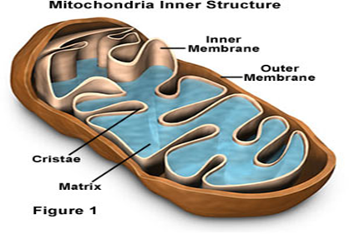
Cellular Respiration
Cellular respiration is the process by which organisms break down food to release its energy. This energy is then stored in ATP (Adenosine triphosphate)
Three parts to ATP
1) adenine (Nbase)
2) ribose (5-C sugar)
3) 3 phosphates (high energy)
ATP/ADP cycle – when energy
is needed for cell work ATP
loses a phosphate to become ADP
Overall equation: C₆H₁₂O₆ + 6O₂ → 6CO₂ + 6H₂O + 38 ATP
Respiration can be aerobic or anaerobic
Aerobic = Oxygen is required.
Anaerobic = No Oxygen is required.

Slide 8
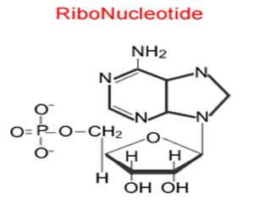
DNA, RNA, and Protein Synthesis
DNA and RNA are composed of nucleotides
DNA RNA____________
Deoxyribose Ribose
A, C, G A, C, G
Thymine Uracil
Double helix Single helix
Codes for proteins/RNA Copy of DNA info
Replication – the process used by cells to copy DNA – enzyme unzips DNA and each side of the ladder acts as a template for the building of the new half. Use the N-base paring rules : A-T ; C-G
EX) TACGGAC (old strand)
ATGCCTG (new strand

Slide 9
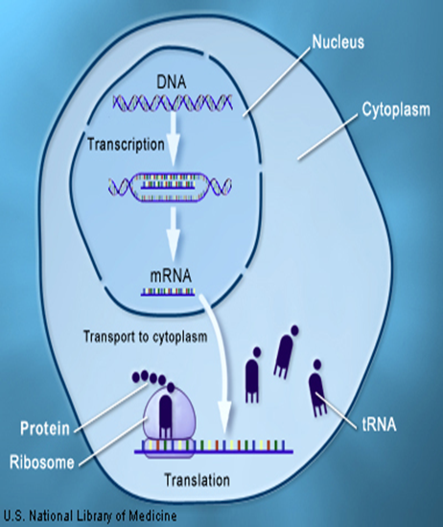
DNA, RNA, and Protein Synthesis
Transcription – the process of making RNA from DNA
EX) TACGGAC (template DNA strand)
AUGCCUG (RNA built)
3 Types of RNA have a
role in protein synthesis
1) mRNA – messenger-blueprint
for how to build protein
2) tRNA – transfer - carries amino
acids to ribosome
3) rRNA – ribosomal – makes up
a ribosome

Slide 10
DNA, RNA, and Protein Synthesis
Translation – the process of
of building a protein by matching
Codons in mRNA to anticodons
of tRNA (use codon chart)

Slide 11
Reproduction
Reproduction is a fundamental characteristic of life
2 form: asexual and sexual
Asexual Sexual____________
-1 parent -2 parents (usually)
-No gametes -Fusion of gametes
-Offspring are genetically identical -Offspring genetically unique
to the parent (clones)
-Fast, efficient, less energy -Slower, less efficient, more energy
Notes:
-Gametes are an organism's reproductive cells.

Slide 12
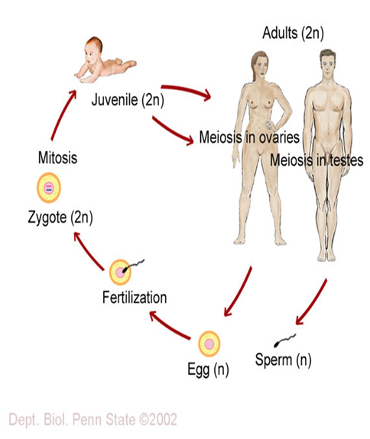
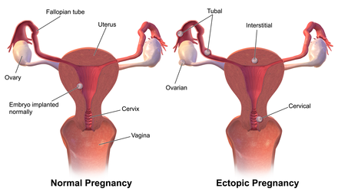
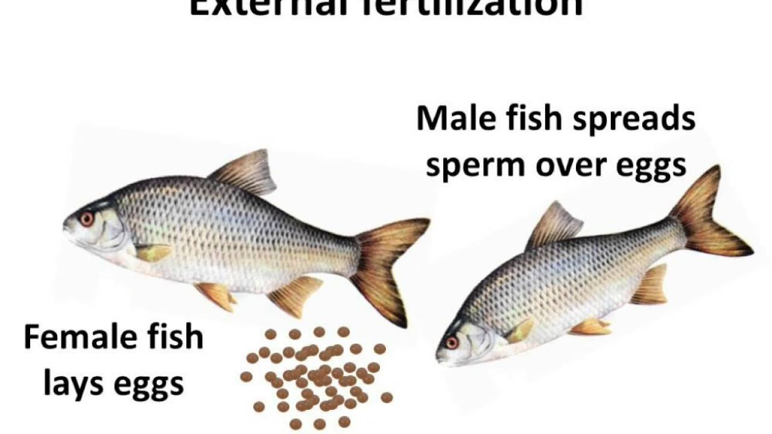
Reproduction cont..
Asexual Strategies
1) binary fission
2) budding
Sexual strategies
1) Internal fertilization
Male & Female Reproductive Organs –
sperm meets egg in female
2) External fertilization
Spawning – eggs and sperm
released into the environment
usually aquatic
In humans fertilization occurs
in the fallopian tube.
Notes:
Binary fission ("division in half") is a kind of asexual reproduction. It is the most common form of reproduction in prokaryotes such as bacteria.
It is most commonly associated with bacteria and yeast, but some animal species reproduce via budding, too. A parent organism creates a bud from its own cells, which then form the basis of the offspring organism and develop into an organism resembling the parent.

Slide 13
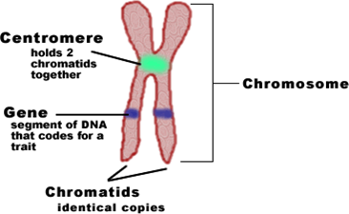
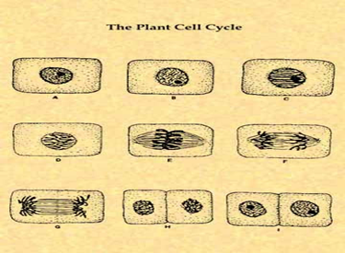
Cell Division
The cell cycle
Mitosis creates diploid cells and is for
the purpose of tissue repair and growth
in animals.
DNA coils to form chromosomes
during cell division
Stages of the cell cycle: Interphase, Prophase, Metaphase,
Anaphase, Telophase, Cytokinesis

Slide 15
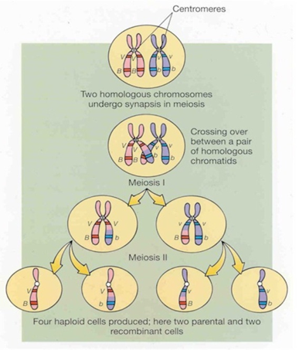
Cell Division Cont…
Meiosis – cell division that creates 4
haploid cells called gametes – aka –
reduction division
Meiosis involves 2 divisions – Meiosis I
and Meiosis II
Meiosis I has some special events:
In Prophase I homologous chromosomes
pair up and crossing over occurs. This
recombination increases genetic
variation for the species
Metaphase I – Pairs line up
Anaphase I – pairs are separated
Meiosis II is similar to mitosis

Slide 16
Class-Work
Do all questions on pages 29-35 & Pages 40-42.
Make sure to study from your packet. Tomorrow you will get tested on 34 random questions from it. (: Please be prepared!!!

Slide 17
NO TALKING!!!!
- Today we will continue to review for the BIO EOC.
You are not allowed to sit by any of the computers. If you do not follow these rules. It will be an automatic detention.
If you talk, you will receive an infraction, and after three infractions you will receive a detention. (NO MATTER HOW MUCH I LOVE YOU)LOL (:
JUST STAY FOCUSED, I WANT YOU TO PASS!!!(:

Slide 18
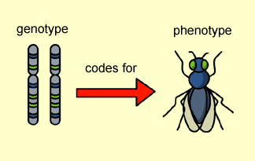
Simple Genetics
Gregory Mendel worked with pea plants to learn the basic patterns of inheritance.
Phenotype – what the organism looks like
Genotype – the gene combination – either Homozygous (TT) or Heterozygous (Tt).

Slide 20
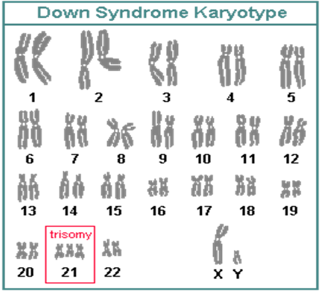
Complex Genetics
Incomplete Dominance – blended phenotype
Ex) When red roses, which contain the dominant red allele, are mated with white roses, which is recessive, the offspring will be heterozygotes and will express a pink phenotype.
Codominance – both parental phenotypes show up in offspring
Ex) Chickens → Black x White →Black and White feathers
Sex Linkage – genes carried on sex chromosomes
Ex) hemophilia, color blindness Cross shows a
carrier female and a normal male. For a female to
inherit the trait the father must have it and the
mother must at least be a carrier
Polygenic Inheritance – traits controlled
by many genes Ex) Height, hair color.
Aneuploidy – condition caused by
having abnormal chromosome number.
Ex) Down’s Syndrome aka Trisomy 21

Slide 21
DNA Technology
Today, DNA techniques include:
1) DNA Extraction – the opening of cells to separate/isolate DNA from other cell parts
2) Cutting DNA – large DNA molecules are cut into smaller fragments using restriction enzymes. These enzymes recognize and cut DNA at specific sequences.
3) Separating DNA – DNA fragments can be separated and analyzed using gel electrophoresis. This process allows scientists to compare genomes of different organisms, separate genes, and create DNA “fingerprints”
Sequencing DNA – this process allows scientists to determine the sequence of N-bases in DNA.
5) Recombinant DNA – scientists can cut DNA from two sources with the same restriction enzyme and combine them. This is used in genetic engineering. This process has been used to create human proteins used to treat disease, create pest-resistant crops, and for many other purposes.
6) Copying DNA – polymerase chain reaction (PCR) has been developed that makes many copies of a small amount of DNA.

Slide 22
Class-Work
Do all questions on pages 61-66.
Make sure to study from your packet as well as all the notes you wrote out in your journal, from the beginning of the year!!! The Biology EOC is quickly approaching!!! (: Please be prepared!!!

Slide 23
Evolution
Charles Darwin – proposed that organisms (species or populations) change over time
Occurs by Natural Selection – “survival of the fittest”
Lines of evidence
1) fossils (geologic time)
2) Homologous Structures –
same basic structure formed from
same embryonic tissue.
3) Analogous Structures – same
basic functions due to same
environmental pressures.
4) Vestigial Structures – structures
that have lost function ex) appendix.
5) Embryology – embryos of various
species appear identical.

Slide 24
Evolution
6) Biochemistry – DNA and protein amino acid sequence comparisons
Adaptive radiation – an ancestral
species radiates or diverges into many
species. Ex) Galapagos Finches
Origin Ideas
Urey and Miller simulated Earth’s early environment and created organic compounds like amino acid
Endosymbiont theory – eukaryotic
cells formed when prokaryotic cells began
to live together permanently

Slide 25
Kingdoms
How are organism placed into their kingdoms?
1) Cell type, complex or simple
2) Their ability to make food
3) The number of cells in their body
Five Kingdom System: Mon
1. Monera – All prokaryotic (such as bacteria)
2. Protista – most are unicellular, eukaryotic, and aquatic
3. Fungi – all eukaryotic heterotrophs that act as decomposers
4. Plantae – all eukaryotic autotrophs
5. Animalia – all eukaryotic heterotrophs that must eat other organisms for food

Slide 26
Plants
Plant cell structure – cell walls, large vacuole, chloroplasts
Photosynthesis
Classification – 4 groups
1) Nonvascular – no true roots/stems/leaves – ex) mosses (Bryophytes)
2) Seedless vascular plants – Ferns
3) Vascular with seeds in cones – Gymnosperms (pines, fir, spruce)
4) Vascular with seeds in fruits – Angiosperms – flowering plants
Types of Vascular Tissue
A) Xylem – transports water from roots to leaves
B) Phloem – transports sugars from leaves to roots
Reproductive Life Cycle – called Alternation of Generations

